Slide 1

Artificial intelligence
Lecture 3. Classification problem – logistic regression
prof. Krzysztof Rybinski

Slide 2
You learned so far
How to estimate linear model in Python
How to choose a good linear model
How to implement linear regression model as a machine learning task
Please note that so far, all outcome (dependent) variables were numerical, changing over a wide range of possible values
Today we will learn how to handle categorical variables using logit models

Slide 3
Learning by doing
Please remember, you learn not when you listen to my lecture …
… not when you watch online videos …
… but when you apply learned methods to solving new problems …
… when you program in Python yourselves

Slide 4
Regression vs. Classification
In regression problems you are trying to predict the numeric value of the independent (outcome) variable
Examples: predict student GPA next year, predict sales of some goods, …. ?
In classification problems you analyze what factors influence the fact that outcome belongs to a given category or you predict to what category someone (something) will belong
Examples: will student fail (0) or pass(1), what causes that someone does not smoke (0) or smokes (1), or should worker be given a wage increase
There could be 2 or more categories, for now we focus on 2

Slide 5
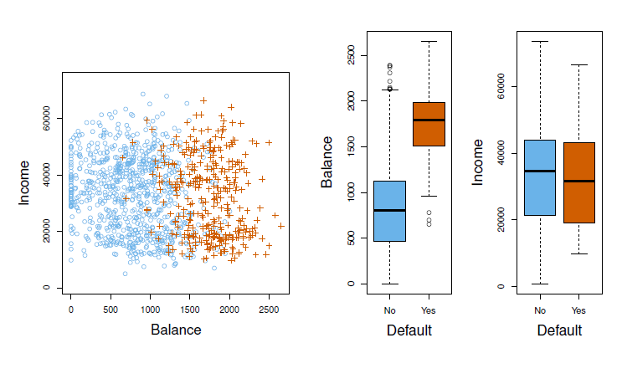
Can we use linear regression here?

Slide 6
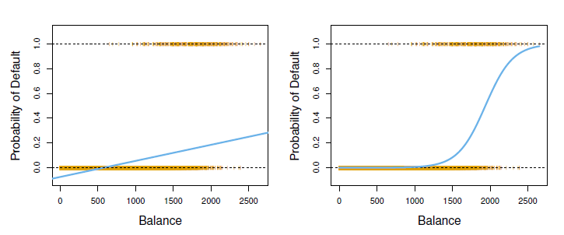
Can we use linear regression here?

Slide 7
Problem – should teacher get a raise
Narxoz HR Committee meets in January/February and in June each year to decide who should get a wage increase (1) or not (0)
We analyze four factors:
- results of KPI assessment (1 unacceptable, 2 below expectations, 3 – in line woth expectations, 4 – above expectations)
- quality of teaching: NPS (-100,+100), less is worse and course grades given by students (0-2), less is worse
- quality of research
- additional achievements
From June 2016 we also take into account negative behaviour
Source: Rybinski, K., Tsay, V. (2018) "Application of machine learning to faculty assessment a case study of Narxoz University", Zarządzanie Zasobami ludzkimi, ZZL 3-4(122)/2018

Slide 8
Logistic regression (logit model)
Predict probability that teacher will get a wage increase, denote it as P(y=1)
P(y=0) = 1 – P(y=1)
K variables (factors) that influence this probability: x₁, x₂, x₃, …., x_{K},
Recall the linear regression model:
  y_{i} = β₀ + β₁x_{1i} + β₂x _{2i} + … + β_{K}x _{Ki} + ε_{i}
i=1,2, …, N

Slide 9

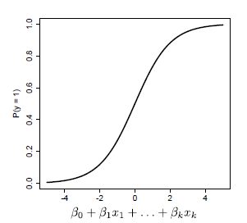
Logistic regression (logit model)
We will use logistic response function:

Slide 10




Logistic regression, how it works
Large +
Large -
Very small
1 + very small is close to 1, but a little bigger
1 divided by (1 + very small) is close to 1, but a bit smaller

Slide 11

Logistic regression, how it works
Large -
Large +
Very big
1 + very big is very big
1 divided by very big is close to zero

Slide 12
How you decide about category
Logit model gives a probability for a set of explanatory variables (factors): x
How to decide to which category assign (outcome variable): y
Any idea?

Slide 13
How you decide about category
Logit model gives a probability for a set of explanatory variables (factors): x
How to decide to which category assign (outcome variable): y
Any idea?
If P(y=1) >= t , assign to category „1”
If P(y=1) < t , assign to category „0”
How to decide about t ?
t is called threshold

Slide 14
How to choose proper threshold?
If t is large (for example 0.8), you will rarely assign „1” category
For example management will give wage increase only to very best teachers
If t is small (for example 0.3), you will very often assign „1” category
For example management will give a wage rise to many teachers (if wage increase budget is big)
If you have no idea what is the proper choice, set t=0.5

Slide 15
Example
Can computers replace
people in company HRM function?

Slide 16
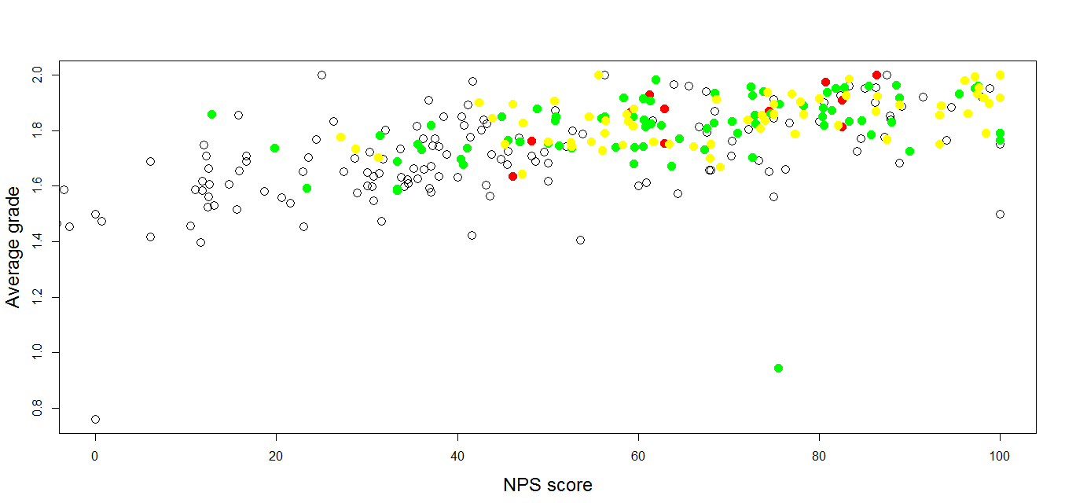
HR Committee decissions, Jan 2016

Slide 17
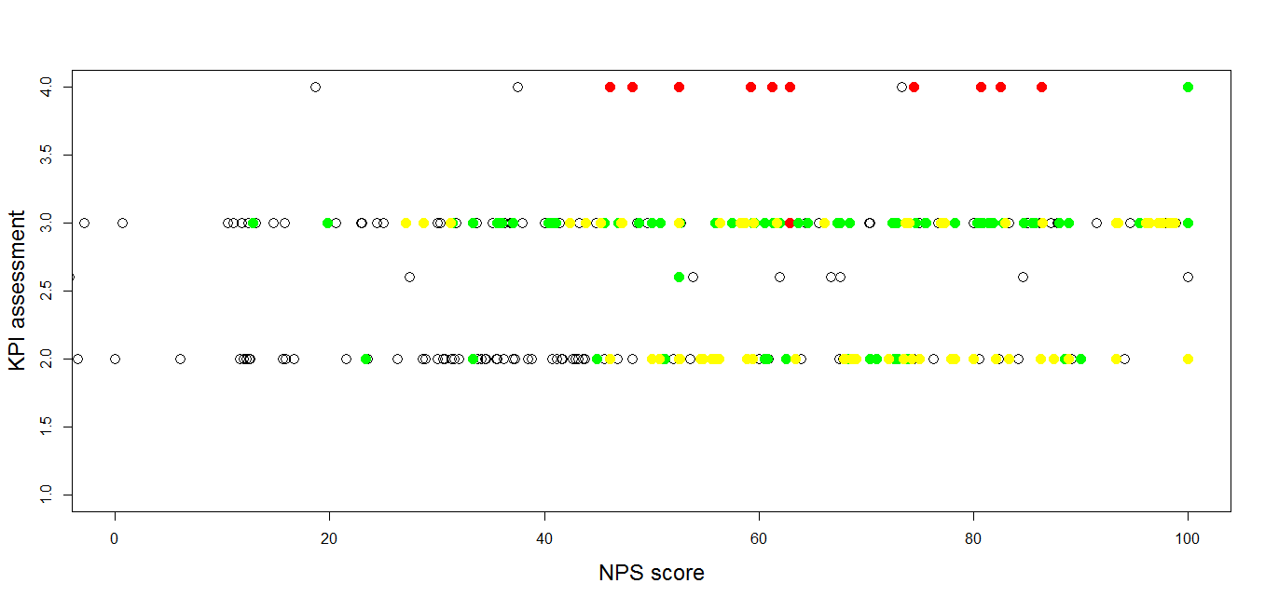
HR Committee decissions, Jan 2016

Slide 18
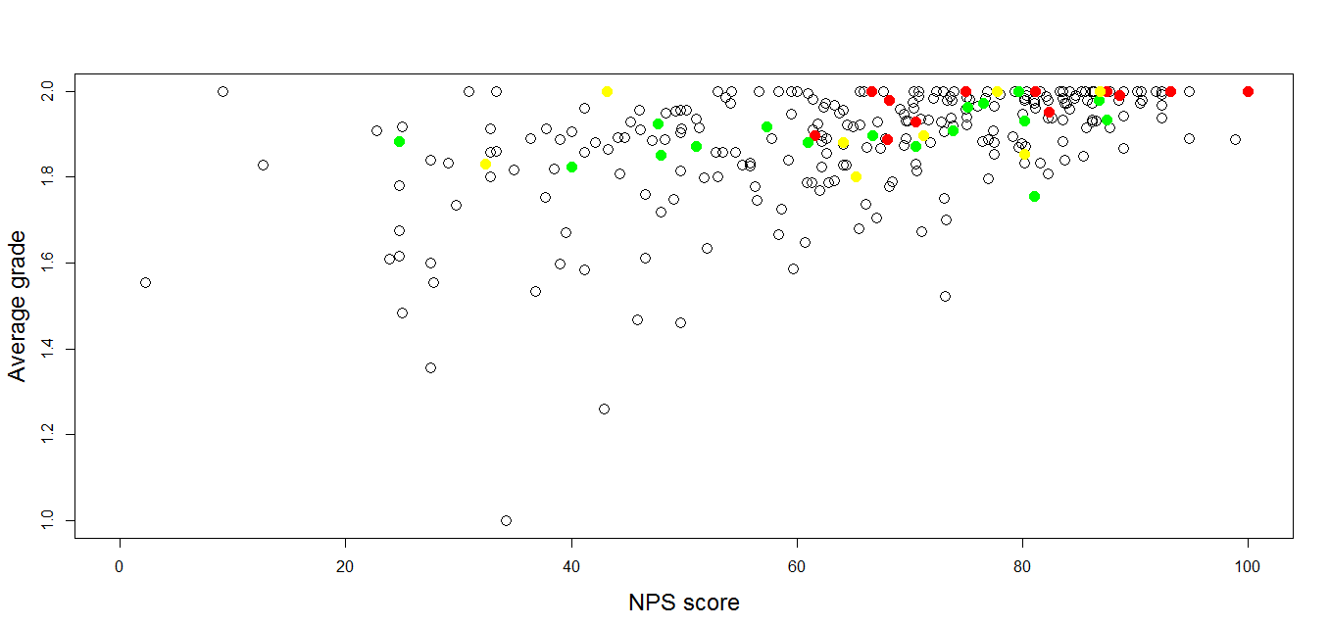
HR Committee decissions, June 2016

Slide 19
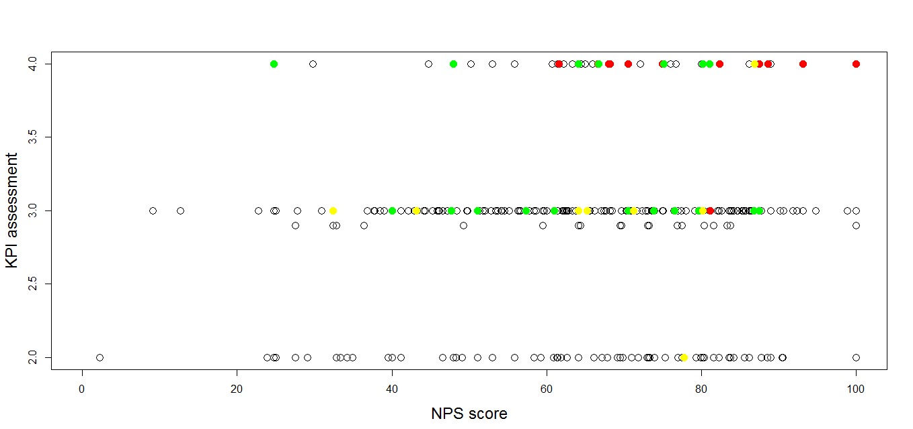
HR Committee decissions, June 2016

Slide 20
Single variable logit models
Response: received wage increase (1), or not (0)
Variable (one for separate model) | Estimate | P-value
KPI | 0.7161 | 0.000***
Number of questionnaires | -0.0024 | 0.214
Average grade | 6.9140 | 0.000***
NPS | 0.0353 | 0.000***
Additional achievement | 1.1900 | 0.000***

Slide 21
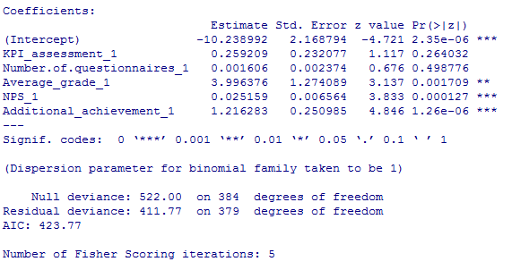
HR Committee decissions, logit model
What do you see?
What surprised you?

Slide 22
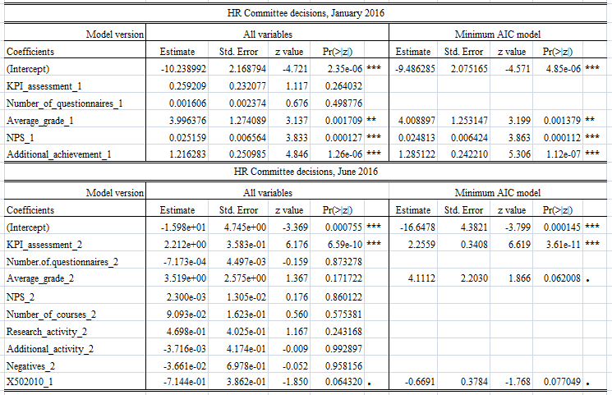
HR Committee decissions, logit model

Slide 23
Comparing univ. and multv. models
Single logit / Multivariate logit
Variable | Estimate | P-value | Estimate | P-value
KPI | 0.7161 | 0.000*** | 0.25920 | 0.264
Number of questionnaires | -0.0024 | 0.214 | 0.00160 | 0.498
Average grade | 6.9140 | 0.000*** | 3.99637 | 0.002**
NPS | 0.0353 | 0.000*** | 0.02515 | 0.000***
Additional achievement | 1.1900 | 0.000*** | 1.21628 | 0.000***

Slide 24
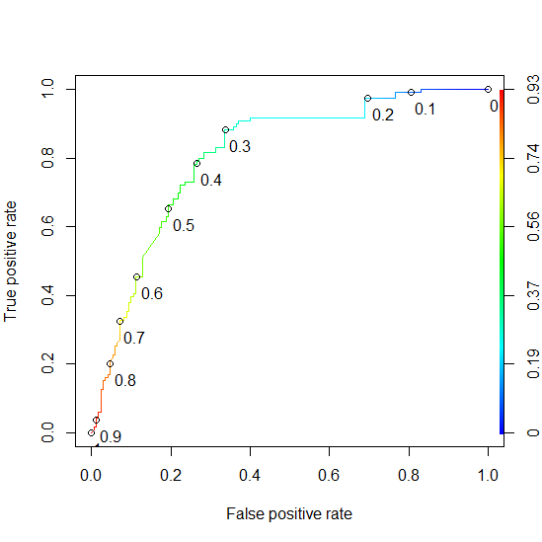
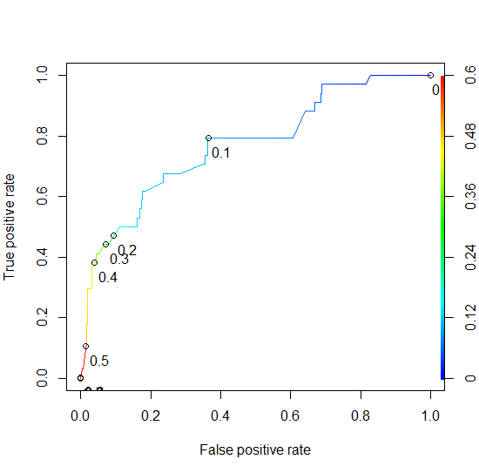
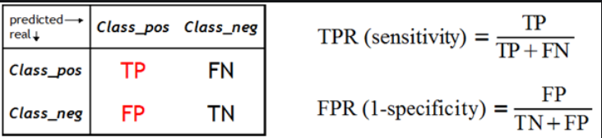
Using ROC curve for t determination
Selecting the threshold value,
when Prob(y=1) > threshold, predict wage increase
HR Committee, January 2016
HR Committee, June 2016

Slide 25


Logit model predictive power
Confusion matrix
(out of sample)
Accuracy
Base Logit
59% 75%
88% 84%
January 2016 |  | Negative | Positive
 |  | Predicted NO | Predicted YES
 | Wage raise: NO | 37 (TN) | 19 (FP)
 | Wage raise:YES | 4 (FN) | 36 (TP)
June 2016 |  | Negative | Positive
 |  | Predicted NO | Predicted YES
 | Wage raise: NO | 75 (TN) | 10 (FP)
 | Wage raise:YES | 6 (FN) | 6 (TP)

Slide 26
Human vs. computer
We analyzed performance of faculty members that were evaluated in January 2016, what were their achievements in June 2016 (avg. score, higher is better)
Faculty achievements’ score in June 2016
 | Computer said NO | Computer said YES
No wage increase in Jan 2016 | 5.84 | 6.63
Yes, wage increase in Jan 2016 | 6.23 | 6.65

Slide 27
What you have learned in lecture 3
Apply logit model in classification problems
Estimate and interpret logit models
Make predictions and selecting proper prediction threshold using ROC curve
Calculate confusion matrix and model prediction accuracy

Slide 28

Next: Lab 3 – classification with logit
If you have any questions send me an email to rybinski@rybinski.eu

Slide 29
prof. Krzysztof Rybinski
rybinski@rybinski.eu
Narxoz: all for the student

